Slide 1
Lab2 Solution&Hint
Yao Zhao

Slide 2
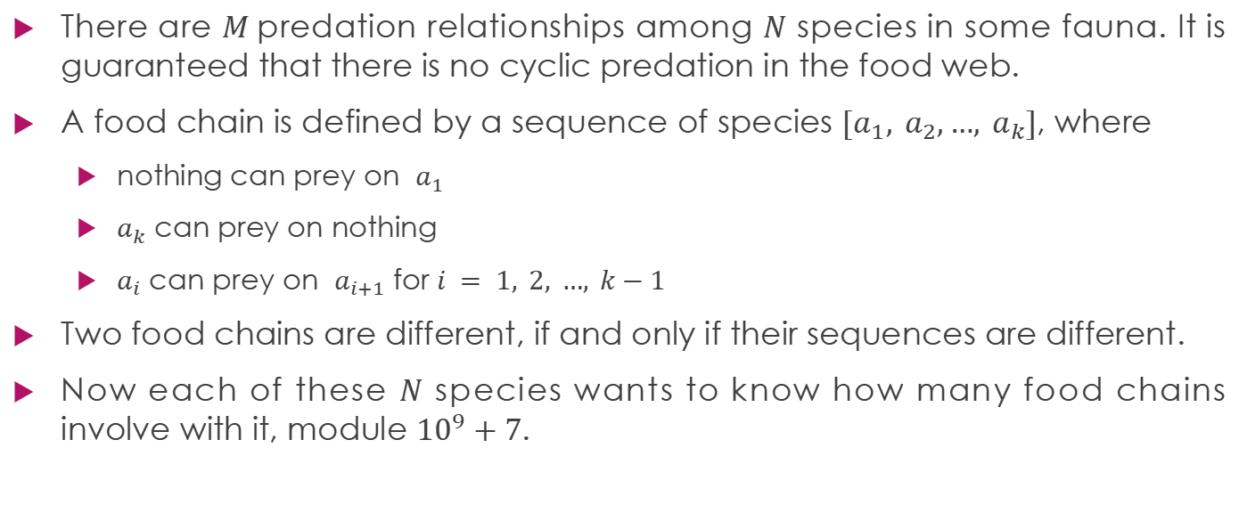
Lab3.A: Food chain
There are $M$predation relationships among $N$ species in some fauna. It is guaranteed that there is no cyclic predation in the food web.
A food chain is defined by a sequence of species $[a_{1}, a_{2},…, a_{k}]$, where
nothing can prey on $a_{1}$
$a_{k}$ can prey on nothing
$a_{i}$ can prey on $a_{i+1}$ for $i = 1, 2, …, k−1$
Two food chains are different, if and only if their sequences are different.
Now each of these $N$ species wants to know how many food chains involve with it, module ${10}^{9}+7$.

Slide 3
Sample Input 1
species | food chains | number
1 | [2,3,1] [2,4,3,1] [2,4,5,1] | 3
2 | [2,3,1] [2,4,3,1] [2,4,5,1] | 3
3 | [2,3,1] [2,4,3,1] | 2
4 | [2,4,3,1] [2,4,5,1] | 2
5 | [2,4,5,1] | 1
5 6
4 5
4 3
2 4
3 1
2 3
5 1
1
3
2
5
4
Sample Output 1
3 3 2 2 1

Slide 4
species | food chains | number
1 | [7,5,1] | 1
2 | [2,4] [2,3,4] [2,6] [2,3,6] | 4
3 | [2,3,4] [2,3,6] | 2
4 | [2,4] [2,3,4] | 2
5 | [7,5,1] | 1
6 | [2,6] [2,3,6] | 2
7 | [7,5,1] [7,8] | 2
8 | [7,8] | 1
Sample Input 2
1
6
8 8
2 4
7 5
3 4
3 6
2 6
7 8
2 3
5 1
3
5
2
8
4
7
Sample Output 2
1 4 2 2 1 2 2 1

Slide 5
species | food chains | number
1 | [2,3,1] [2,4,3,1] [2,4,5,1] [2,3,6,1] [2,4,3,6,1] | 5
2 | [2,3,1] [2,4,3,1] [2,4,5,1] [2,3,6,1] [2,4,3,6,1] | 5
3 | [2,3,1] [2,4,3,1] [2,3,6,1] [2,4,3,6,1] | 4
4 | [2,4,3,1] [2,4,5,1] [2,4,3,6,1] | 3
5 | [2,4,5,1] | 1
6 | [2,3,6,1] [2,4,3,6,1] | 2
Sample Input 3
6 8
4 5
4 3
2 4
3 1
2 3
5 1
3 6
6 1
6
1
3
2
5
4

Slide 6
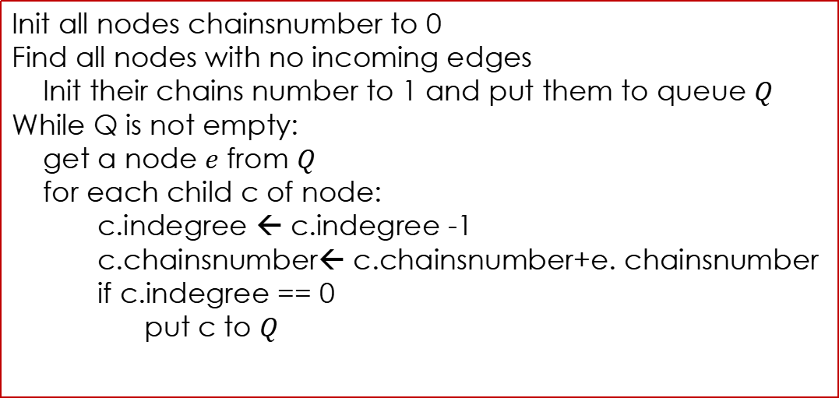
Try to find all topo order and update the chains number of each node
Init all nodes chainsnumber to 0
Find all nodes with no incoming edges
Init their chains number to 1 and put them to queue $Q$
While Q is not empty:
get a node $e$ from $Q$
for each child c of node:
c.indegree ← c.indegree -1
c.chainsnumber← c.chainsnumber+e. chainsnumber
if c.indegree == 0
put c to $Q$
6
1
3
2
5
4
Why?
1 | 2 | 3 | 4 | 5 | 6
5 | 1 | 2 | 1 | 1 | 2
Can’t find all chains number

Slide 7
species | food chains | number | result
1 | [2,3,1] [2,4,3,1] [2,4,5,1] [2,3,6,1] [2,4,3,6,1] | 5 | 5
2 | [2,3,1] [2,4,3,1] [2,4,5,1] [2,3,6,1] [2,4,3,6,1] | 5 | 1
3 | [2,3,1] [2,4,3,1] [2,3,6,1] [2,4,3,6,1] | 4 | 2
4 | [2,4,3,1] [2,4,5,1] [2,4,3,6,1] | 3 | 1
5 | [2,4,5,1] | 1 | 1
6 | [2,3,6,1] [2,4,3,6,1] | 2 | 2
Only find the combination before the node
How to find all?

Slide 8
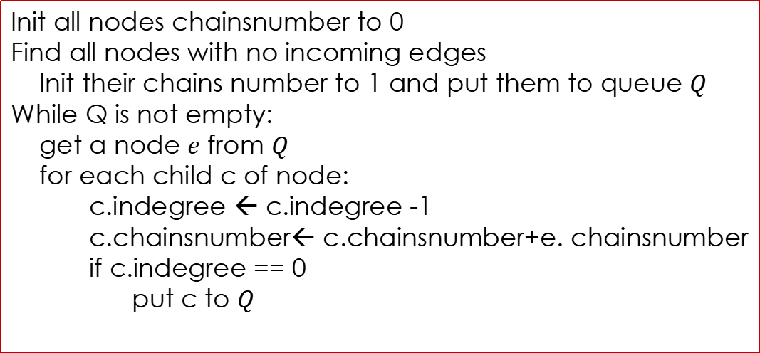
Reverse the edges and execute again：
Init all nodes chainsnumber to 0
Find all nodes with no incoming edges
Init their chains number to 1 and put them to queue $Q$
While Q is not empty:
get a node $e$ from $Q$
for each child c of node:
c.indegree ← c.indegree -1
c.chainsnumber← c.chainsnumber+e. chainsnumber
if c.indegree == 0
put c to $Q$
6
1
3
2
5
4
1 | 2 | 3 | 4 | 5 | 6
1 | 5 | 2 | 3 | 1 | 1
Reverse

Slide 9
species | food chains | number | Result | Reverse-result
1 | [2,3,1] [2,4,3,1] [2,4,5,1] [2,3,6,1] [2,4,3,6,1] | 5 | 5 | 1
2 | [2,3,1] [2,4,3,1] [2,4,5,1] [2,3,6,1] [2,4,3,6,1] | 5 | 1 | 5
3 | [2,3,1] [2,4,3,1] [2,3,6,1] [2,4,3,6,1] | 4 | 2 | 2
4 | [2,4,3,1] [2,4,5,1] [2,4,3,6,1] | 3 | 1 | 3
5 | [2,4,5,1] | 1 | 1 | 1
6 | [2,3,6,1] [2,4,3,6,1] | 2 | 2 | 1
number = result * Reverse

Slide 10
Recommended data structure
0
6
1
3
5
3
6
2
3
4
2
0
1
3
2
1
6
3
2
2
4
2
2
3
5
4
1
2
5
1
1
5
4
0
Out degree
1
4
1
1
Point to out edges list
6
1
3
In degree
0
Point to in edges list

Slide 11
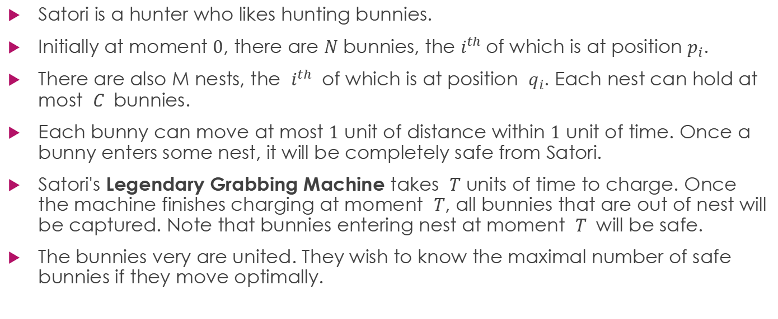
Lab3.B: Legendary Grabbing Machine
Satori is a hunter who likes hunting bunnies.
Initially at moment $0$, there are $N$ bunnies, the $i^{th}$of which is at position $p_{i}$.
There are also M nests, the $i^{th}$ of which is at position $q_{i}$. Each nest can hold at most $C$ bunnies.
Each bunny can move at most $1$ unit of distance within $1$ unit of time. Once a bunny enters some nest, it will be completely safe from Satori.
Satori's Legendary Grabbing Machine takes $T$ units of time to charge. Once the machine finishes charging at moment $T$, all bunnies that are out of nest will be captured. Note that bunnies entering nest at moment $T$ will be safe.
The bunnies very are united. They wish to know the maximal number of safe bunnies if they move optimally.

Slide 12
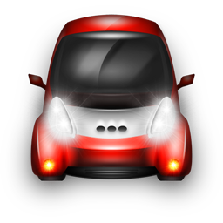

Input:
2 2 1 5
45 55
40 60
Legendary Grabbing Machine
40
45
50
55
60
65

Slide 13
Input:
2 2 1 5
45 55
40 60
Output:
2
Legendary Grabbing Machine
40
45
50
55
60
65

Slide 14
Input:
2 2 1 5
55 65
40 60
Legendary Grabbing Machine
40
45
50
55
60
65

Slide 15
Input:
2 2 1 5
55 65
40 60
Output:
1
Legendary Grabbing Machine
Only hold 1 rabbit
40
45
50
55
60
65

Slide 16
Hint：
Sort the nests by position
Sort the bunnies by position
Start from one direction or another, greedily fill the nests

